Slide 1


FA27 Series
New Generation Multi-use Indoor LED Products

Slide 2
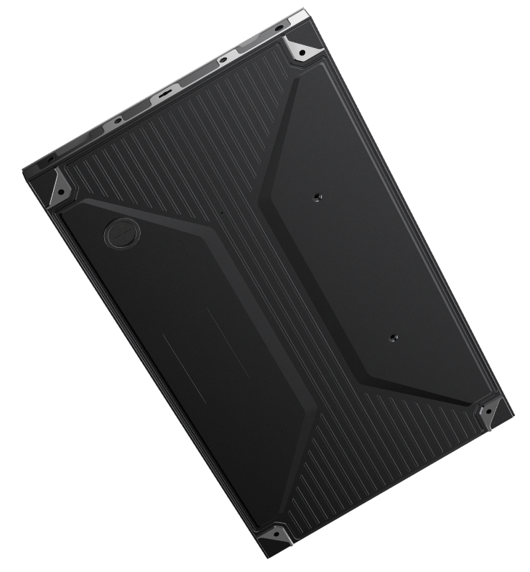
Focused on What Matters Most:
Display · Structure · Delivery Efficiency
Born for engineering displays

Slide 3


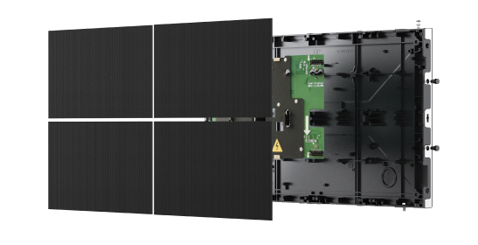



Easier Choice, Simpler Delivery
Make your choice easier!
SMD & COB cover different needs for easier decision-making
Simpler Deployment
Lightweight cabinets, integrated system, large modules & front service greatly enhance the delivery efficiency
More Flexible Installation
Support Wall-mounted, hanging, curved, 90 degree corner
SMD
COB
Notes:
1.配图---应该是阶梯教室

Slide 4


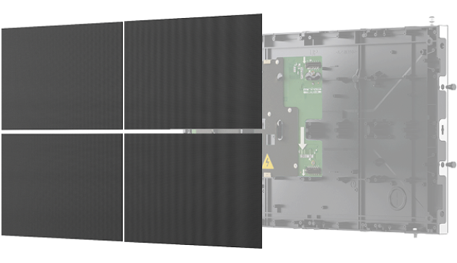
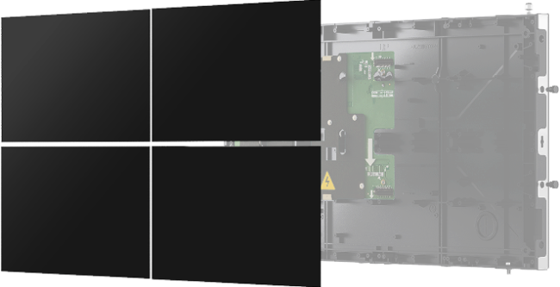
FS27
FC27
SMD
COB
Mature technology, wide application and easy maintenance.
More suitable for standardization and large-scale production.
Chip-scale package (CSP) enhances contrast and uniformity, delivering a more delicate close-range viewing experience.
P1.8 / P2.5
P0.9 / P1.2 / P1.5
Notes:
1.配图---应该是阶梯教室

Slide 5

Visual Performance
From standard display to refined viewing, Tailored for different project needs

Slide 6



Different Packaging Options for Different Application Needs
PWM Dithering Across the Series
Smoother Gradation, More Natural Visuals
3840Hz Refresh Rate Across the Series
More Stable Motion Performance
PWM
3840Hz
Normal
COB with optical film protection; optional GOB for SMD, with HOB available for P2.5.
Notes:
1.配图---应该是阶梯教室

Slide 7
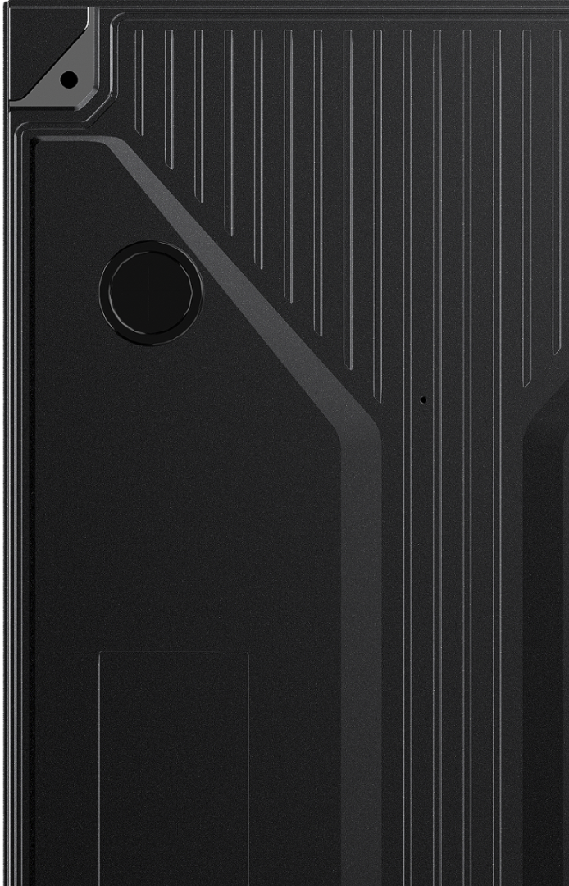
Fast Installation & Delivery
From cabinet design to on-site installation,
FA27 is optimized for delivery efficiency.

Slide 8
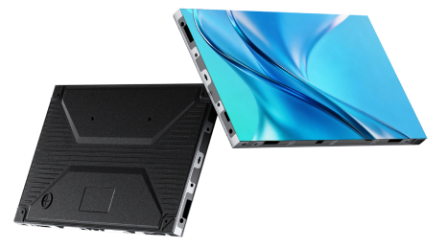
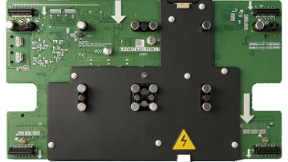

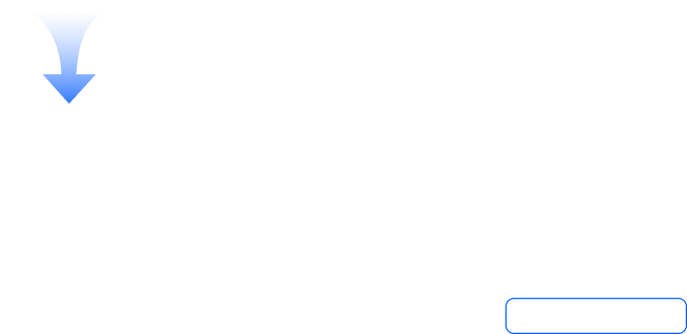
Standard Cabinet & Highly-integrated System
16:9 Standard Cabinet
Lightweight & Slim Structure
Highly Integrated System
Easy configuration for standard resolutions
Easy to transport and move
3-in-1 board reduces complexity and failure points
22
%
Weight decrease
Only
3.4kg
Dust-proof · Anti-static · EMI-resistant · Anti-shock · Fire-proof · RoHS
Notes:
1.配图---应该是阶梯教室

Slide 9
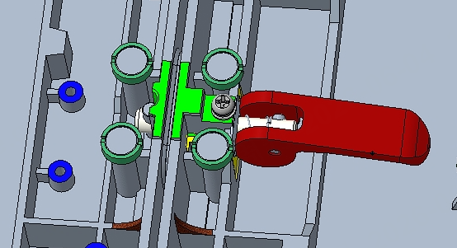
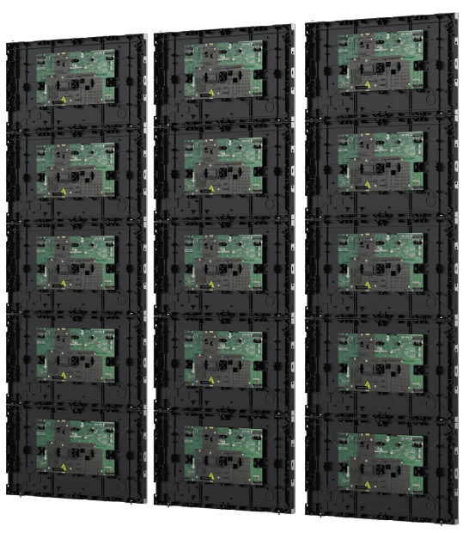
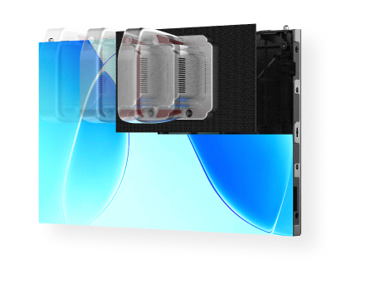
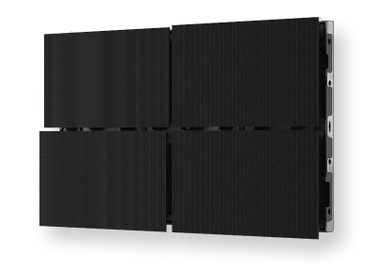



Faster Installation, Easier Maintenance
Large Module Design
Pre-assembly* and quick lock
Full Front Service
Easy to install, less splicing seams
Reduced on-site installation time
No rear access required
* Pre-assembly is optional and subject to project configuration.
Notes:
1.配图---应该是阶梯教室

Slide 10
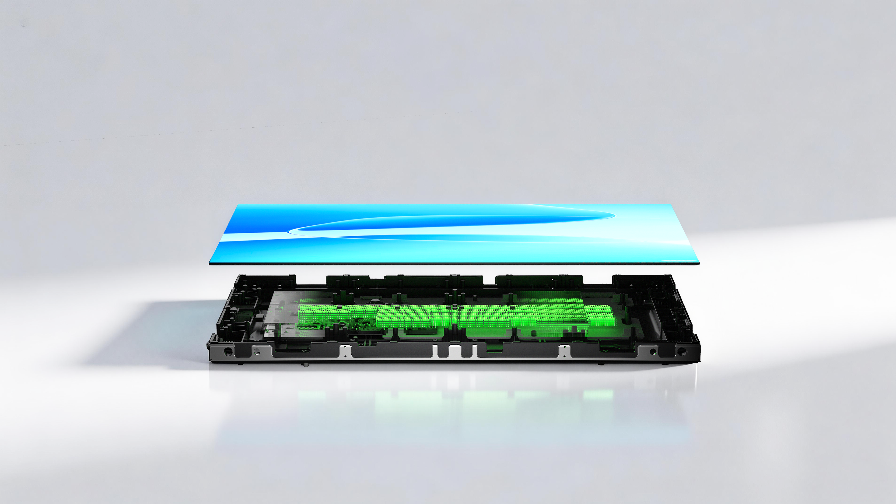
Reengineered Electronics for Higher Efficiency
An optimized circuit layout reduces unnecessary power loss, improves overall power efficiency, and helps keep the screen exceptionally cool.
Notes:
1.配图---应该是阶梯教室

Slide 11

Flexible Installation for Any Cases
Adaptable to various scenarios with no limitation
Notes:
1.配图---应该是阶梯教室

Slide 12

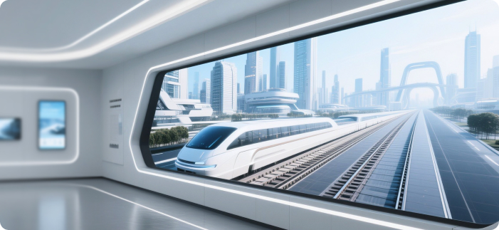
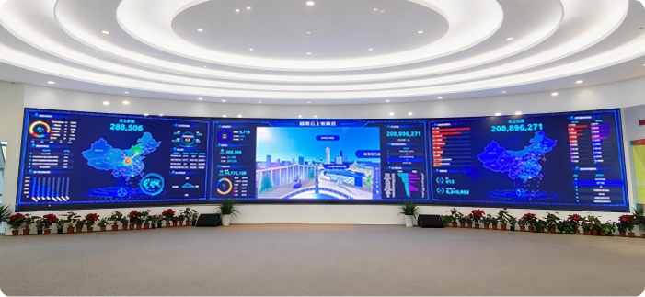

Various Indoor Applications
Corporate & Training
Showrooms
Central Control Center
Retail & Advertisement
Notes:
1.配图---应该是阶梯教室

Slide 13
Specifications
Model | FS2718 |  | FS2725 |  | FC2709 |  | FC2712 | FC2715
Packaging | SMD |  |  |  | COB
PixelPitch(mm) | 1.8 |  | 2.5 |  | 0.9 |  | 1.2 | 1.5
Module Resolution (dots) | 160×90 |  | 120×135 |  | 320×180 |  | 240×135 | 192×108
Cabinet Resolution (dots) | 320×180 |  | 240×135 |  | 640×360 |  | 480×270 | 384×216
Module Size(mm) | 300×168.75 |  | 300×337.5 |  | 300×168.75
Cabinet Size(W×H×D)(mm) | 600×337.5×31
Cabinet Material | Magnesium Aluminum
Cabinet Weight (kg) | 3.4±0.1
Gray Scale(Bit) | 14 | 14 |  | 13 |  | 13 |  |  | 14
Contrast | 6500:1 |  |  |  | 15000:1
Refresh Rate(Hz) | 3840
Brightness (nit) | 550 |  | 600 |  | 800 |  | 800 |  |  | 600
Viewing Angle(H/V°) | 160 / 160 |  |  |  | 170 / 170
Power Consumption (Max./Ave.)(W/m²) | 296 / 99 |  | 341 / 114 |  | 380 / 127 |  | 301 / 100 | 286/95
Maintenance | Front Access
Notes:
1.配图---应该是阶梯教室

Slide 14
Thanks
www.maxhub.com
sales@maxhub.com
MAXHUB_Global

